Slide 1

Optical Mirrors Experiment Simulation
Group 08
G.kalaiyarasi
J.jesitha
S.jeyarani
S.sutharsika

Slide 2
SCOPE & PURPOSE
we expect pupils can learn about optical physics in a friendly, interactive environment.
It will be like getting image and ray diagram for object's position from mirrors like convex, concave and plane mirror.
We made that dynamic like we can drag the object towards or backward from mirrors.

Slide 3
Languages & license
We develop our project using
javascript
Html & CSS languages.
We used MIT license.
We use kineticjs (JavaScript library) and jquery
We are contributing this project in the opt_sim through the Mozilla Science Lab.

Slide 4
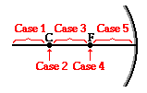
Process Overview
In this experiment, there are three categories with convex, concave, plane mirror. Each categories works five different cases such as object beyond C/2F, object between F and C/2F, object at C/2F, object at F, object within F.

Slide 5
DEMO

Slide 6
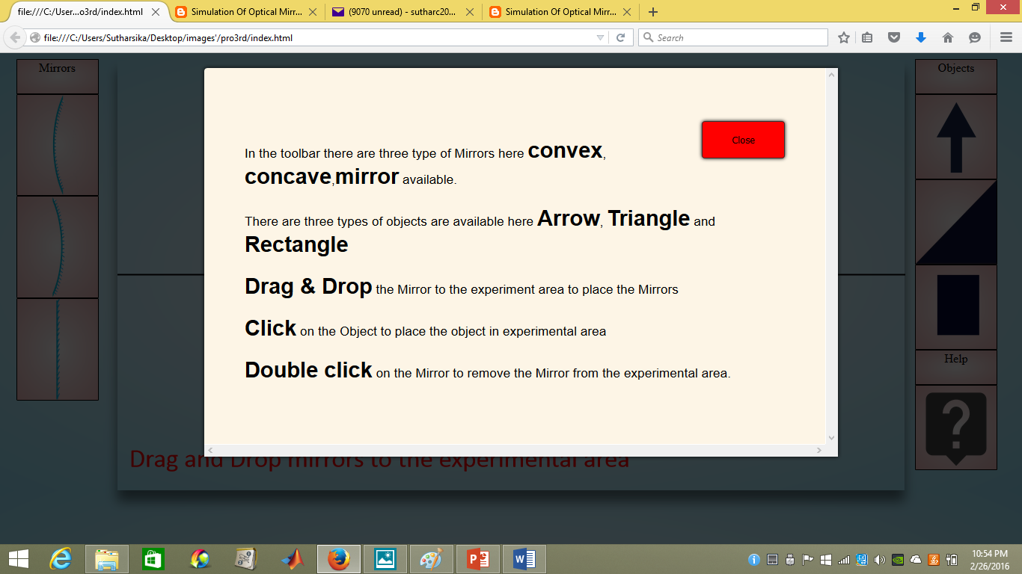

Slide 7
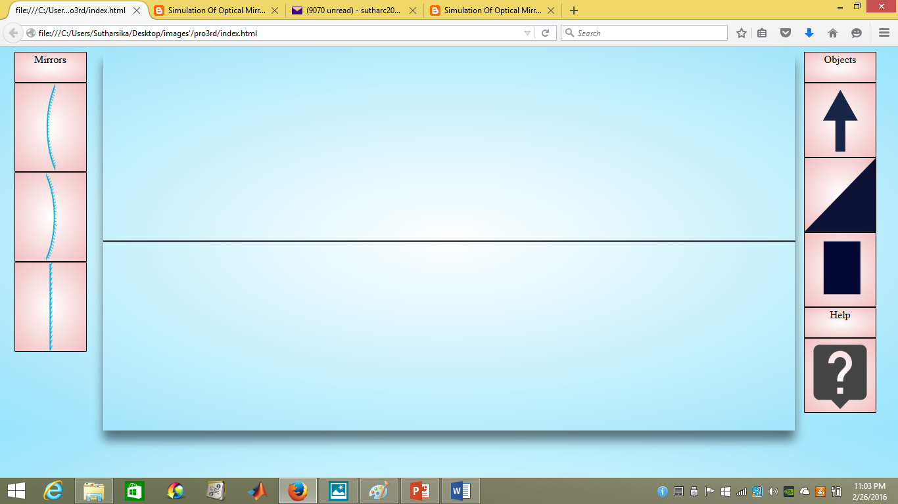

Slide 8
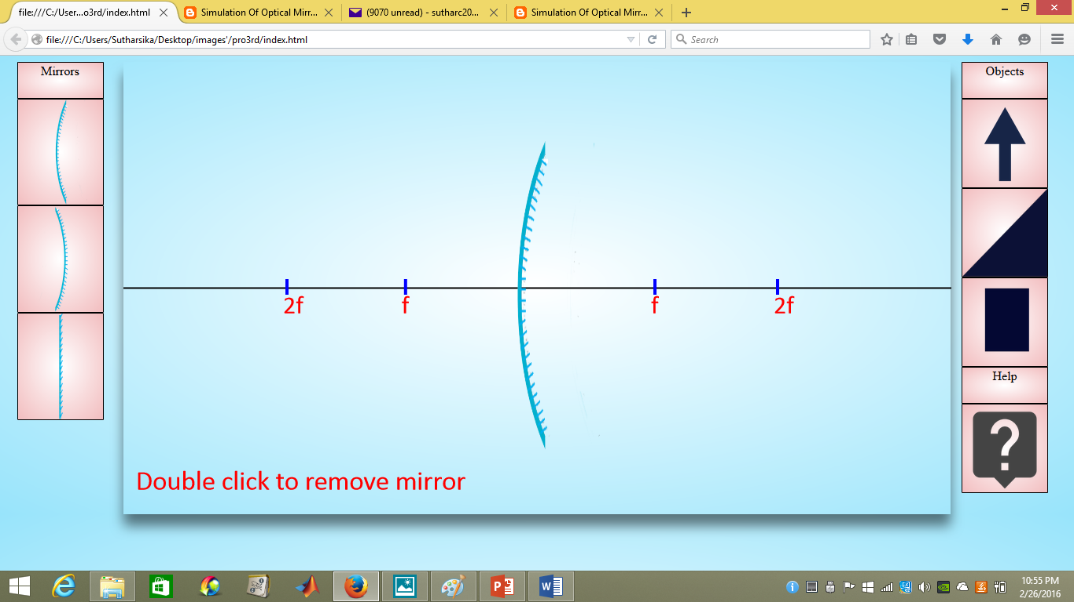
Demo…

Slide 9
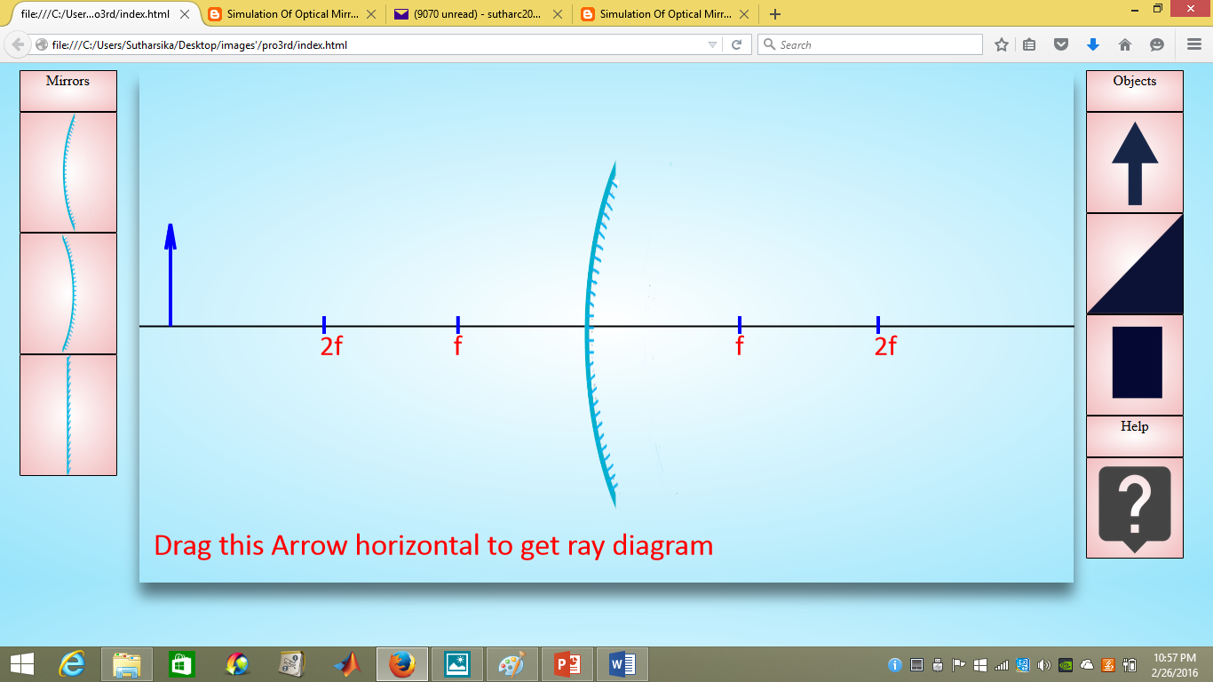
Demo…

Slide 10
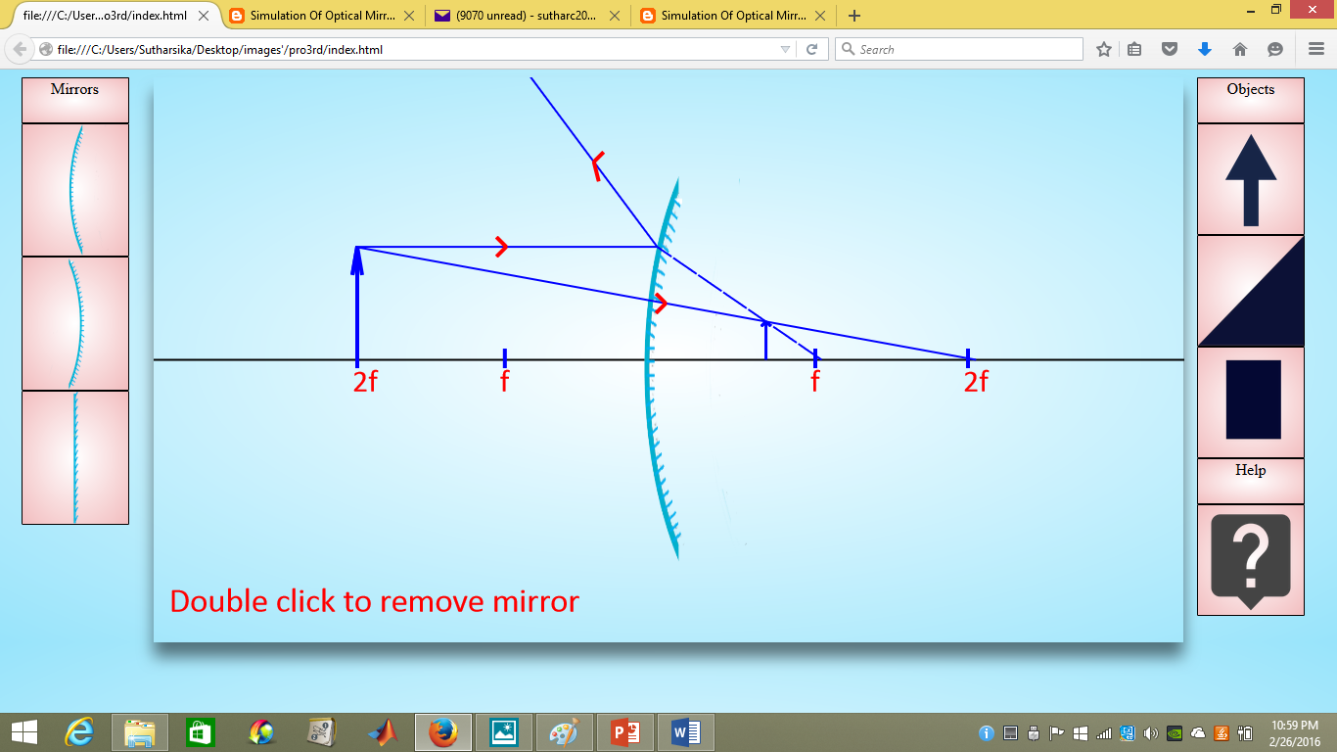
Demo…

Slide 11
Advantage of our system
It is very helpful for under the A/L students.
Here we add the help include some clear information.
We can get output of the object in any position of the horizontal plane.
We can understand the optical mirror simulations dynamically.

Slide 12
Drawbacks of the System
Only we can get the output for one mirror at a time.
We did not include about the size of the Image.

Slide 13
Future work…
we'd like to give students the ability to combine lenses and mirrors in their simulations.
After successfully simulating lenses & mirrors, we'd also like to include calculations part for image distance and magnification.

Slide 14
We can see our project here
Interface on mocapps
https://moqups.com/Ashakalai/S9qWcP5s
Blog-updates
http://optmirrorsjk.blogspot.com/
GIThub-project
https://github.com/kalaiyarasiganeshalingam/opt_simV2

Slide 15


Slide 16


